Slide 1

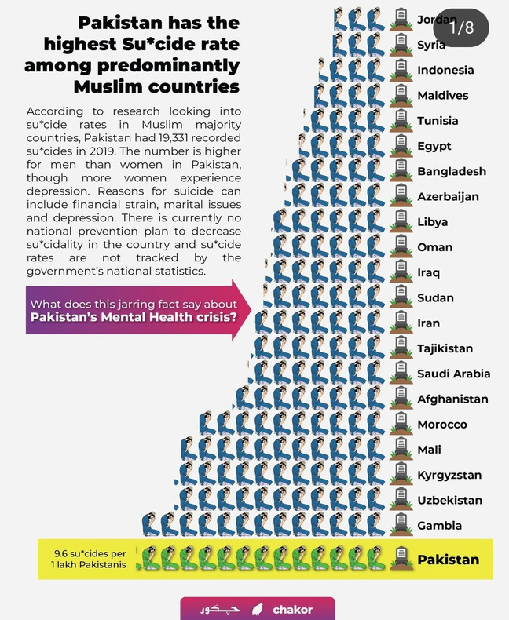
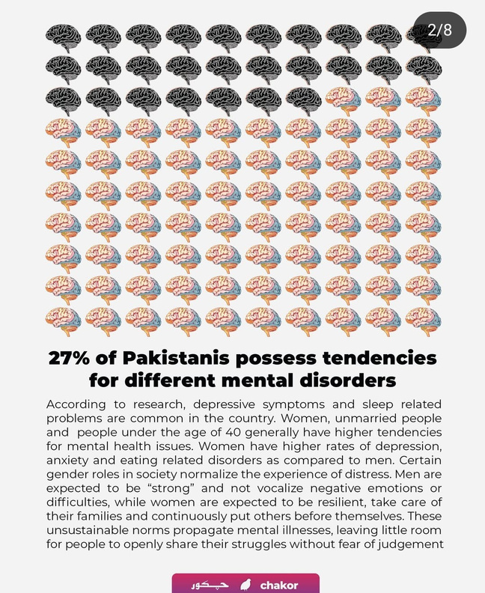

AI in Psychiatric Care:
Early Detection and Personalized Intervention
Why this?
1

Slide 2



Local Problem
2

Slide 3
Local Dataset
3

Slide 4


Understanding psychiatric disorrders
Psychiatric disorders: Conditions affecting mood, thinking, behavior (e.g., depression, anxiety, schizophrenia).
Multifactorial etiology: Caused by genetics, environment, culture.
Challenge: Subjective diagnostics lead to delays in treatment.
4

Slide 5
Why did we choose this project?
Personal connection: Friends and family members struggling with mental health inspired our interest.
Mental health stigma, especially in men, often leads to silence and suffering.
Cultural biases label emotional expression in men as weakness.
Lack of open dialogue about mental illness—particularly in male communities.
A need for accessible, stigma-free tools to support mental health.
Belief in AI’s potential to provide early detection, personalized care, and reduce barriers.
5

Slide 6

AI models and algorithms in mental health
AI models: Ellipsis Health (speech), MHDeep (wearables), Proactive Emotion Tracker (multimodal).
Algorithms: Machine learning (ML), natural language processing (NLP), deep learning (DL).
Purpose: Detect disorders like depression using voice, text, or physiological data.
6

Slide 7


Our research contribution
Methodology: Used CatBoost model with text, speech, and wearable data.
Dataset: 500 samples, 35 features (e.g., mood, sleep, symptoms).
Findings: 87% accuracy in detecting disorders, supports personalized interventions.
7

Slide 8
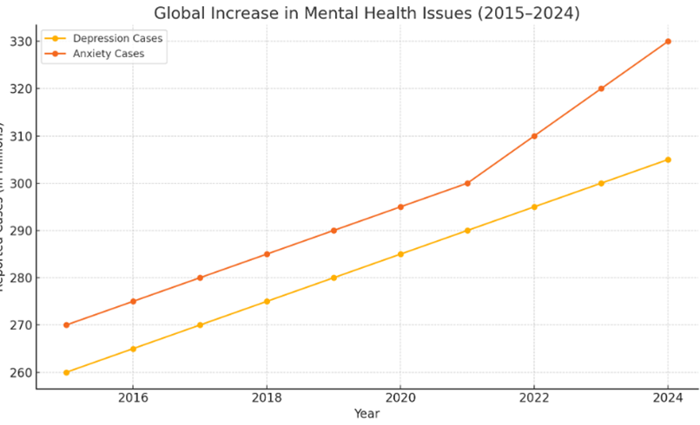
Global Increase in Mental Health Issues
Abdullah Bilal
8

Slide 9

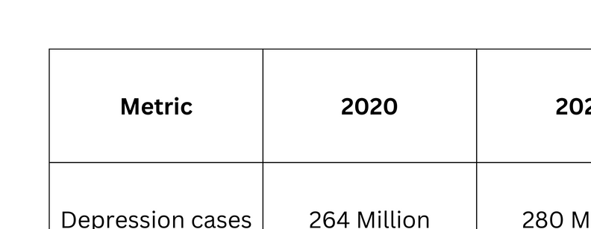

Table Showing the increase in the Mental Health Issue
9

Slide 10




Problem Statement
Current psychiatric diagnostics heavily rely on subjective self-reports and clinical evaluations, leading to:
Inaccuracy and diagnostic delays.
Absence of objective measures for early detection.
Challenges in personalized interventions.
Challenges in Psychiatric Disorder Detection
Factors like subjectivity, symptom diversity, and lack of biomarkers make early and accurate diagnosis difficult.
Limitations of Traditional Diagnostic Approaches
Overreliance on self-reports, shortage of mental health professionals, and stigma reduce the effectiveness of current psychiatric evaluations.
Barriers to Early Intervention
Lack of scalable, objective tools and varied access to mental health literacy hinder timely treatment—especially in low-resource and culturally diverse settings.
10

Slide 11
Background and Theoretical Framework
Traditional Methods for Mental Health Detection
Clinical Interviews
Conducted by professionals
Time-consuming and subjective
PHQ-9 / GAD-7 Questionnaires
Self-reported scales
Risk of misunderstanding or bias
DSM-5 Assessments
Comprehensive but complex
Not scalable for mass screening
Limitations:
Slow, costly, subjective
Limited accessibility
11

Slide 12

Limitations of Traditional Methods
Subjectivity: Diagnosis often depends on the patient's self-reported symptoms.
No Objective Tests: Lack of reliable biological markers for mental health conditions.
Symptom Variability: Same disorder may appear differently in different individuals.
Stigma: Fear of judgment stops many from seeking early help.
Cultural Bias: Diagnoses can be influenced by cultural norms and clinician bias.
Delayed Detection: Early symptoms are often subtle and overlooked.
12

Slide 13

Hypothesis
Zaigham
🧪Key Hypothesis
AI-based multimodal systems can improve early detection and personalized care by identifying patterns and correlations in large datasets .
🗣️ Beyond Traditional Methods
AI, especially NLP and machine learning, can assess mental health through speech, text, and behavioral data.
📊 Multimodal Data Utilization
AI systems integrate diverse data (e.g., imaging, biomarkers, social media) for accurate mental disorder classification.
.
13

Slide 14
Hypothesis
📈 Early Detection & Prediction
AI enables automated risk screening and early illness detection—vital for conditions like depression and suicide risk.
🎙️ Speech as a Diagnostic Tool
Voice analysis can non-invasively monitor emotional states and predict mental health crises.
🧬 Personalized Treatment Plans
AI helps identify new biomarkers and predict individual responses to treatments, enabling tailored care strategies.
14

Slide 15
Ethical Considerations
🔒 Privacy & Confidentiality
Secure handling of sensitive data is crucial to protect patient privacy and prevent misuse.
📝 Informed Consent
Patients must be clearly informed and consent to how their data and AI tools are used.
⚖️ Bias & Fairness
AI can amplify biases; fairness needs diverse data, monitoring, and inclusive design.
🔍 Transparency & Accountability
AI decisions must be explainable, with clear responsibility for errors or harm.
15

Slide 16
Ethical Considerations
🧍‍♂️ Autonomy & Oversight
AI should assist—not replace—human judgment, preserving patient autonomy.
🛡️ Safety
AI must be rigorously tested and monitored for safety and real-world effectiveness.
📘 Training & Guidelines
Mental health professionals need clear guidance and training to use AI ethically.
📉 Changing Mental States
AI must adapt to the dynamic nature of mental health, not rely on static data.
16

Slide 17
Literature Review
Hamza 22P9222
01
Mental health problems affect millions of people around the world.
02
These problems impact how we live and feel.
03
Early and accurate detection is very important.
04
Traditional ways, like interviews with doctors, are not always accurate or easy to access.
17

Slide 18
Different Models for AI-based Mental Health Detection
01
Ellipsis Health App – by Ellipsis Health
02
Woebot Health by (Kathleen Kara Fitzpatrick)
03
MHDeep – by Independent Researchers (arXiv, 2021)
04
Proactive Emotion Tracker – by Independent Researchers (arXiv, 2024)
05
Speech-Based Mental Health Models – by Various Institutions (arXiv, 2024)
06
Explainable AI via Social Media – by Independent Researchers (arXiv, 2024)
18

Slide 19
Ellipsis Health (by Ellipsis Health)
OverView
Ellipsis Health uses AI to find depression and anxiety by studying speech and voice features.
It looks at both the words used and the way people speak to judge mental health.
Model
Uses deep learning and NLP to analyze voice data.
Applications:
Used for mental health screening, especially for older adults.
Can monitor health through smartphone apps.
19

Slide 20
Ellipsis Health Study Summary
Study Summary (Frontiers in Psychology, 2022):
Tested on older people (average age 63) with weekly voice screenings.
Achieved 82% accuracy in detecting depression and anxiety.
Transformer models worked better than older models.
Strengths:
Non-invasive (doesn’t require touching the person).
Works for people of all ages.
Limitations:
Depends on the person following the instructions.
Only uses voice data (can’t detect other signs).
20

Slide 21
Woebot Health by (Kathleen Kara Fitzpatrick)
Overview:
Woebot is a smart chatbot that helps people with depression, anxiety, and stress.
It talks to users like a friend and gives support using simple tips from cognitive behavioral therapy (CBT).
It also asks how you're feeling each day and helps you manage your mood with friendly chats.
Model Type:
Uses NLP and rule-based conversation models. Trained with psychological frameworks like CBT
Applications:
Daily check-ins and mood tracking.
Early detection and support for depression and anxiety.
Personalized mental health support via mobile app.
21

Slide 22
Woebot Study Summary
Study Summary (JMIR, 2017):
A study of 70 college students showed that those who used Woebot reported a significant decrease in depression symptoms after 2 weeks compared to the control group. Users found it engaging and easy to use.
Strengths:
Easily accessible through smartphones.
Focuses directly on anxiety and depression.
Based on clinically proven CBT techniques.
Limitations:
Not a replacement for therapists.
Rule-based responses can feel repetitive over time.
22

Slide 23
MHDeep by (arXiv)
Overview:
MHDeep detects mental health problems (like depression, bipolar disorder) using wearable devices (smartwatches).
It tracks things like heart rate and movement to monitor mental health continuously.
Model Type:
Uses neural networks like RNNs, CNNs, and transformers to analyze data from wearables.
Applications:
Helps detect mental health problems early.
Monitors health using smartwatches or smartphones.
23

Slide 24
MHDeep Study Summary
Study Summary (arXiv, 2021):
Tested on 74 people using smartwatches for 1.5 hours of data.
Achieved 100% accuracy in detecting depression and other disorders in some cases.
The system is fast and works well in real-time.
Strengths:
Very accurate.
Non-invasive (doesn’t bother the person).
Works continuously.
Limitations:
Only uses body data (no speech or text).
Needs a wearable device.
24

Slide 25
References
Ellipsis Health Study, Frontiers in Psychology, 2022.
[1]https://www.frontiersin.org/journals/psychology/articles/10.3389/fpsyg.2022.811517/full
Woebot Health
[2]https://mental.jmir.org/2017/2/e19/
MHDeep Study, arXiv, 2021.
[3] https://arxiv.org/abs/2102.10435
25

Slide 26
Proactive Emotion Tracker
Mian Misbah Ur Rahman 22P9356
Objectives
Methodology
Monitoring of Mood from Social Media data
Investigate factors for mood swings
Improve overall Mental Health wellness
Create a Script to extract User Browser History
Dataset creation and Model training
26

Slide 27
Proactive Emotion Tracker
Model Architecture
Extract & Analyze users browser history
used ‘Transfer learning’ on BERT model to predict whether a given sentence is depressive or not.
Transfer learning is a ML technique where a model trained on one task is reused or finetuned for a different but related task.
Analyze this data to detect the severity level of depression.
27

Slide 28
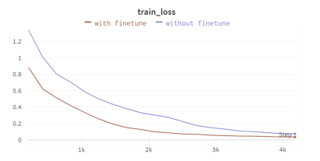
Proactive Emotion Tracker
Results
Y-axis shows value of training loss
X-axis shows training steps
Y=0, means perfect model / zero errors
Y=1.2, means lots of mistakes made
28

Slide 29
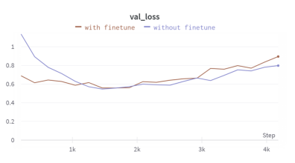
Proactive Emotion Tracker
Results
Y-axis shows validation loss
val. loss: measure of model’s wrong predictions
X-axis shows training steps
lower val. loss means model is better at making predictions
29

Slide 30
Speech-Based Mental Health Models
This Study explores Three Models
Whisper
wav2vec
HuBERT
turns spoken words into written text. Its encoder pulls out the meaning of the words and the sound details, like tone. It works really well with natural, unplanned speech, like in conversations.
Also self-supervised, it predicts masked audio segments but struggles with its last layer due to fine-tuning for speech recognition
A self supervised model trained to predict masked audio parts
30

Slide 31
Speech-Based Mental Health Models
Training Process
Pre-Training: Models are pretrained on large datasets.
HuBERT and wav2vec on ‘Librispeech/Libri-light’ (clean audiobook data), and Whisper on ‘internet-collected audio’ for transcription.
Pre-training tasks include masked prediction (HuBERT, wav2vec) and transcript prediction (Whisper).
31

Slide 32
Speech-Based Mental Health Models
Training Process
Probing
The audio is broken down into small chunks ranging from 0.5 - 20 sec.
They pull out data representations from different layers of the models
they use a logistic regression classifier—to analyze these embeddings and predict mental health conditions, like depression.
32

Slide 33
Speech-Based Mental Health Models
Datasets
Callyope-GP Corpus:
860 French-speaking participants
10.12 hours of audio (16 kHz).
Includes elicited tasks (counting 1-20) and spontaneous tasks (“Describe how you’re feeling”).
.
33

Slide 34
Speech-Based Mental Health Models
Datasets
Androids Corpus:
228 recordings from 118 Italian speakers (64 clinically depressed), ~9 hours.
Includes elicited and spontaneous speech.
.
34

Slide 35
Speech-Based Mental Health Models
Results
HuBERT achieves the best F1 score (0.92) on the Androids spontaneous task, surpassing prior state-of-the-art (SOTA).
It also scores 0.86 on the elicited task.
Whisper performs better on spontaneous speech (best with Whisper-M on Callyope-GP).
wav2vec’s last layer underperforms due to its speech recognition focus.
35

Slide 36
Explainable AI via Social Media
This system detects mental disorders (e.g., depression, PTSD) from social media posts, prioritizing explainability to ensure transparent predictions for clinicians and users.
Model Types
Uses transformer-based NLP (BERT).
graph neural networks (GNNs).
explainable AI (SHAP, LIME) to analyze text, social interactions.
SHAP(shapley additive explanations)
LIME(Local Interpretable Model agnostic Explainations)
36

Slide 37
Explainable AI via Social Media
Transformers & BERT based Models
The study discusses several deep learning models and techniques for mental disorder detection via social media, focusing on their architectures and functionalities.
Examples:
DepressionNet:
Understand Posts: Use BERT to turn user posts into meaningful codes.
Find Key Posts: Apply K-Means clustering to pick important posts.
Summarize Posts: Use BART to create short summaries of key posts.
Analyze with BiGRU: Process summaries and user behaviors using BiGRU and attention layers.
Detect Depression: Combine all data to predict depression signs.
37

Slide 38
Explainable AI via Social Media
Transformers & BERT based Models
Ednet:
Classify Users: EDNet identifies user types related to eating disorders (e.g., ED-users, healthcare professionals).
English-Only Limit: Works only with English data, a key drawback.
Static User Issue: Struggles to track changes in user behavior over time.
38

Slide 39
Problems and Challenges in Mental Health AI Models
Data-Related Challenges
Privacy Concerns: Sensitive voice/text/social data can lead to user mistrust.
Limited Datasets: Most datasets are small, private, or language-specific.
Bias in Data: Demographic and cultural biases reduce model generalizability.
Model-Related Challenges
Overfitting on Small Datasets: Especially in models like MHDeep and Social Media XAI.
Black-Box Behavior: Lack of explainability in deep models (except XAI-focused ones).
Performance Variability: Accuracy drops across age groups, languages, or device types.
Implementation Issues
User Compliance: Voice-based models like Ellipsis rely on regular user input.
Hardware Dependency: MHDeep and Emotion Tracker require wearable sensors.
Scalability: Some models are difficult to deploy at large scale due to computational needs.
39

Slide 40
Conclusion
Key Takeaways
AI is revolutionizing mental health care through speech, text, and physiological analysis.
Models like Ellipsis Health and Speech-Based Models offer non-invasive, accurate screening.
Multimodal systems (e.g., Proactive Emotion Tracker) enable real-time emotional tracking.
Explainable AI increases trust and interpretability in sensitive applications.
Challenges Remain
Data privacy, model transparency, and user compliance are critical concerns.
Scalability and generalizability across populations need further research.
The Future
Integration of multimodal data, personalized AI, and ethical frameworks can lead to more effective and inclusive mental health tools.
40

Slide 41
Data Collection Methods
Ahmed Ali
01
Electronic Health Record
05
Social media surveys
02
Neuroimaging
06
Public Data Set
03
Genomic Data
04
Digital Phenotyping
41

Slide 42
Data Preprocessing
Sultan Mughal
01
Cleaning
Mean used.
Numerical values
02
Encoding
Labelled Encoding
03
Text Processing
group data replaced with NAN.
42

Slide 43
Feature Extraction
Muhammad Abdullah
What is Feature Extraction?
Transforms high-dimensional data into a compact, informative feature set. Reduces noise and computational complexity while preserving key patterns.
01
Key Techniques:
02
Benefits:
Reduces overfitting
Feature Aggregation
Numerical Transformation
improves model efficiency
Boolean Feature Aggregation
43

Slide 44
Feature Engineering - Creating New Columns
What is Feature Engineering?
Derives new columns from existing ones to uncover predictive patterns. Enhances model performance by leveraging relationships in raw data.
01
Polynomial Features
02
Categorical Transformation
03
Scaling & Normalization
04
Constructed Ratios & Scores
05
Impact
44

Slide 45
Advanced Feature Engineering - Derived Columns
What is Feature Engineering?
Derives new columns from existing ones to uncover predictive patterns. Enhances model performance by leveraging relationships in raw data.
01
Progress Metrics
02
Composite Scores
03
Temporal Features
04
Native Categorical Handling
05
Mismatch Indicators
45

Slide 46
Model selection
Hashim
CatBoost: A Gradient Boosting Algorithm
CatBoost is a powerful, fast, and highly efficient gradient boosting algorithm developed by Yandex. It handles both numerical and categorical data seamlessly and performs well on structured datasets.
Key Features:
Efficient Handling of Categorical Features
Automatically processes categorical data without the need for extensive encoding.
Minimal Data Preprocessing
Requires less feature engineering compared to other models.
High Accuracy
Delivers strong performance on small to medium-sized datasets.
Fast Training Speed
Trains faster compared to deep learning models like BERT.
Robust to Overfitting
Regularization techniques ensure better generalization on unseen data.
Works Well with Tabular Data
Optimized for structured/tabular data, making it a great fit for classification tasks.
46

Slide 47
Model Training and Testing
Abdullah
01
Wrote Code for CatBoost Model
04
Processed Categorical Features
02
Split Data with Stratification
05
Achieved High Accuracy
Trained the Model with Parameters
03
47

Slide 48

Application and Use Cases
25 April, 2025
Mustafa 22P-9221
48

Slide 49
The Role of AI in Mental Health
Overcoming Barriers: AI helps people who avoid therapy due to stigma, cost, or access.
Early Detection: Detects subtle emotional distress early.
Data Analysis: Analyzes vocal tone, behavior, etc.
Accessibility: Provides on-demand support, especially in underserved areas.
Supplementary Tool: Works alongside mental health professionals.
49

Slide 50
Real-World AI Mental Health Tools
Wysa: CBT and mindfulness chatbot for emotional support.
Youper: Tracks mood and offers AI therapy.
Ellipsis Health: Detects anxiety/depression through voice.
Tess: Real-time, text-based AI support tailored to user mood.
Replika: AI companion offering emotional support.
50

Slide 51
Data Sources in AI Mental Health
Text: Chat messages, social media posts (Analyzes language).
Speech/Audio: Voice tone (Detects emotional states).
Wearables: Heart rate, sleep patterns (Identifies stress, inactivity).
Facial Expressions: Webcam analysis (Detects emotions).
Neuroimaging: Brain scans, genetic data (Research purposes).
51

Slide 52
System Workflow Overview
Input: Text, voice, physiological data, optional video.
Preprocessing: Clean and standardize data.
Feature Extraction: Analyze text, speech, wearables, and video.
Feature Integration: Combine features into one representation.
Prediction: AI model predicts risk (Low, Medium, High).
Response: Tailored recommendations (e.g., self-help, counseling).
52

Slide 53
Use Case Example: Sara
Sara's Signs: Text (withdrawal), speech (hesitation), wearables (poor sleep, low activity).
AI Response: Suggests wellness exercises or counselor consultation.
Outcome: Early intervention to prevent worsening of depression.
53

Slide 54
Benefits of AI in Mental Health
Early Detection: Spot problems before they worsen.
Personalized Care: Adapts support based on individual needs.
Continuous Support: Provides help anytime, no appointments needed.
Data-Driven: Consistent, evidence-based insights.
Cost-Effective: Scalable without needing more human resources.
54

Slide 55
Challenges and Considerations
Privacy: Ensure secure data storage and encryption.
Bias: Avoid biased results by using diverse datasets.
Human Oversight: AI should support, not replace, professionals.
55

Slide 56
Future Prospects of AI in Mental Health
Brain-Computer Interfaces: Detect cognitive patterns in real time.
Hybrid Models: AI + human therapists for better care.
Regulatory Approval: Clinical validation for medical use.
Global Access: AI in areas with limited mental health resources.
56

Slide 57
Conclusion
01
Multimodal AI enhances early detection
04
Ethical frameworks ensure responsible integration
Personalized interventions improve treatment outcomes
AI supports, does not replace, clinicians
02
05
03
Explainable AI builds clinician-patient trust
06
Real-world validation expands AI deployment
57

Slide 58
Evaluation Metrics in
AI for Mental Health
Faran Ahmed 22P-9249
58

Slide 59
Overview
01
Why Evaluation Matters
04
AI vs Traditional Diagnosis
Key Metrics Used in
Psychiatric AI Models
Limitations of AI in
Psychiatry
02
05
03
Real Examples & Accuracy
Results
06
Conclusion & Future Scope
59

Slide 60
Why Evaluation Matters
AI models deal with sensitive, life-impacting conditions
Inaccurate predictions can miss critical mental health risks
Evaluation ensures trust, safety, and clinical readiness
Helps determine if a model should be deployed or improved
60

Slide 61
Key Metrics Used in Psychiatric
AI Models
Accuracy: Overall correctness — not always reliable in imbalanced data
Precision & Recall: Helps reduce false positives/negatives
F1-Score: Combines precision and recall for balance
61

Slide 62
AI vs Traditional Diagnosis
Traditional methods are slow, manual, and sometimes subjective
AI enables real-time, scalable monitoring through phones, sensors
AI uses objective signals — like speech tone, behavior, vitals
Can integrate multiple sources, unlike single-symptom methods
62

Slide 63
Limitations of AI in Psychiatry
Bias in training data can lead to unfair predictions
AI struggles with unseen or underrepresented groups
Example: IBM Watson only matched doctors in 56% of cancer cases
AI must provide clear, explainable outputs for clinical use
63

Slide 64
Evaluation Metrics and Performance Estimation
Zarar Ahmad
ROC -AUC
The ROC-AUC metric evaluates the model’s ability to distinguish between classes. A perfect AUC score is 1.0, which indicates ideal separation. This metric helps assess how well the model can differentiate between healthy and mentally ill patients.
64

Slide 65
MAE / RMSE for Regression Models
In severity prediction tasks, regression models use Mean Absolute Error (MAE) and Root Mean Square Error (RMSE) to measure error rates. These metrics help in estimating the degree of deviation in predicted severity from actual conditions.
65

Slide 66
Explainability: SHAP and Attention Scores
Explainability tools such as SHAP and attention scores help clinicians understand how the AI model reached its decisions. These metrics are vital for building trust among medical professionals and for ensuring ethical adoption.
66

Slide 67
Estimating Model Performance and Accuracy
• Ellipsis Health achieved an AUC value of 0.82 by analyzing voice data and validating results against clinical questionnaires.
• The MHDeep system powered by deep neural networks and wearable sensors, delivered 100% accuracy in detecting several psychiatric disorders.
• HuBERT and Whisper speech models achieved an F1-score of 0.92 for detecting depression via natural speech.
67

Slide 68
Limitations and Considerations
AI models often perform poorly on diverse and non-uniform datasets. Clinicians need trustworthy and interpretable information for clinical adoption. Ethical and regulatory concerns must be addressed before full-scale implementation
68

Slide 69
Conclusion & Future Scope
Ali Mustafa
AI can greatly support psychiatric care, not replace it
Ethics, transparency, and fairness must guide its use
Collaboration between data scientists and psychiatrists is key
With proper regulation, AI can enhance early diagnosis and care
69

Slide 70

Thank You
Any Questions
70

